Slide 1

Sentimental analysis on Amazon review using NLP
Social Network and Text Analytics

Slide 2

Introduction
Amazon, a leading e-commerce giant, thrives on providing a seamless and satisfying shopping experience for its customers
However, processing and extracting actionable insights from this vast repository of text data can be challenging, especially when dealing with short or one-line reviews.
This is where sentiment analysis, a powerful data science technique, comes into play.
This project tackles this challenge by implementing sentiment analysis on Amazon customer feedback.
By automatically classifying reviews as positive or negative, we aim to provide Amazon with actionable insights to prioritize areas for improvement.
2

Slide 3

Problem statement
Amazon's Feedback Conundrum: Too much data, too little understanding.
Amazon drowns in a sea of customer feedback, both vast and varied.
While valuable, its sheer volume and often wordy nature make extracting actionable insights a challenge.
This hinders Amazon's ability to improve its services and products, leaving a treasure trove of data untapped.
Tackling this conundrum is key to streamlining feedback processing and making customer-centric decisions for a better Amazon experience.
3

Slide 4

LABEL - Label provides an high level understanding on whether the review is negative or positive
REVIEW - Customer provided reviews
4,00,000 rows
2 columns
Data dictionary
We will be considering a sample of 50,000 records without replacement using sampling technique.
0
1
4

Slide 5




Data Preprocessing
Data preprocessing in natural language processing (NLP) involves cleaning, transforming, and preparing raw text data for further analysis or modeling. It aims to enhance the quality of the text data and make it suitable for machine learning algorithms.
Recommended System Development
Develop a sentiment analysis model using various supervised learning techniques, including Decision Tree classifiers, Random Forest classifiers, and advanced deep learning architectures like Recurrent Neural Networks (RNNs) or Convolutional Neural Networks (CNNs). By leveraging a labeled dataset, the model undergoes training to accurately predict the sentiment of textual inputs, categorizing them as positive, negative, or neutral based on their content.
Feature Engineering
Feature engineering in natural language processing (NLP) involves transforming raw text data into a format that is suitable for machine learning models. It aims to extract relevant information from the text and represent it in a way that enables the model to learn patterns and make predictions effectively
Market Factors & Impact Analysis
The project will undertake a comprehensive analysis to understand how market factors impact different customer segments. This includes assessing the influence of external factors such as interest rates, stock market performance, and gold prices on customer preferences for specific insurance products.
Approach Taken To Address The Problem Statement
5

Slide 6

Data preprocessing
The project aims to create Data preprocessing in natural language processing (NLP) involves cleaning, transforming, and preparing raw text data for further analysis or modeling. It aims to enhance the quality of the text data and make it suitable for machine learning algorithms.
Feature Engineering
Feature engineering in natural language processing (NLP) involves transforming raw text data into a format that is suitable for machine learning models. It aims to extract relevant information from the text and represent it in a way that enables the model to learn patterns and make predictions effectively
Recommended System Development Develop a sentiment analysis model using various supervised learning techniques, and advanced deep learning architectures. By leveraging a labeled dataset, the model undergoes training to accurately predict the sentiment of textual inputs, categorizing them as positive, negative, or neutral based on their content.
Market Factors & Impact Analysis The sentiment analysis recommendation system suggests products or services based on user sentiments. For positive sentiments, it recommends items with positive reviews, high ratings, or favorable feedback to enhance user satisfaction. Conversely, for negative sentiments, it suggests products that have addressed common criticisms or received positive feedback after improvements, aiming to mitigate dissatisfaction and improve user experience.
6

Slide 7







Lowercasing
Tokenization
Data pre-processing
Stop-word Removal
Stemming & Lemmatization
The project aims to create Data preprocessing in natural language processing (NLP) involves cleaning, transforming, and preparing raw text data for further analysis or modeling.
It aims to enhance the quality of the text data and make it suitable for machine learning algorithms.
Removing Punctuation
Removing Special Characters and Digits
Replacing the Target variable with proper label
7

Slide 8
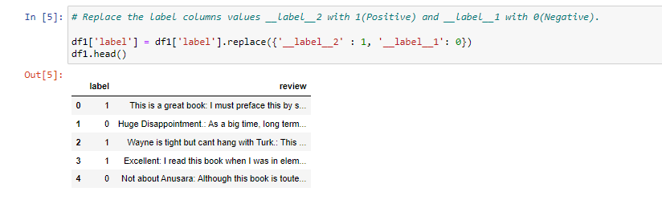
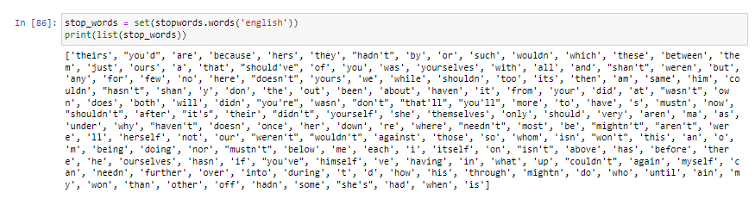
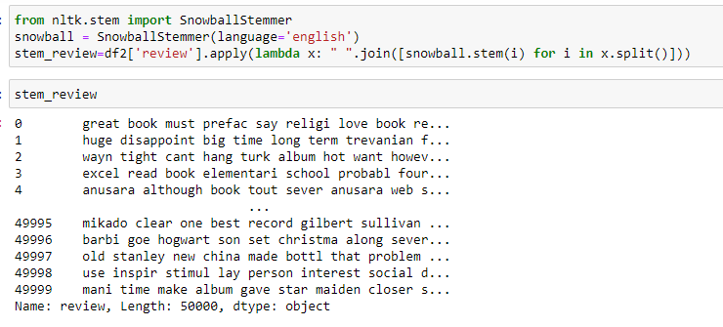
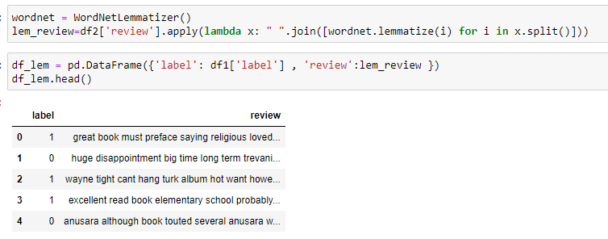
Replacing the Target variable with proper label
Stop-word Removal
Stemming
Lemmatization
8

Slide 9
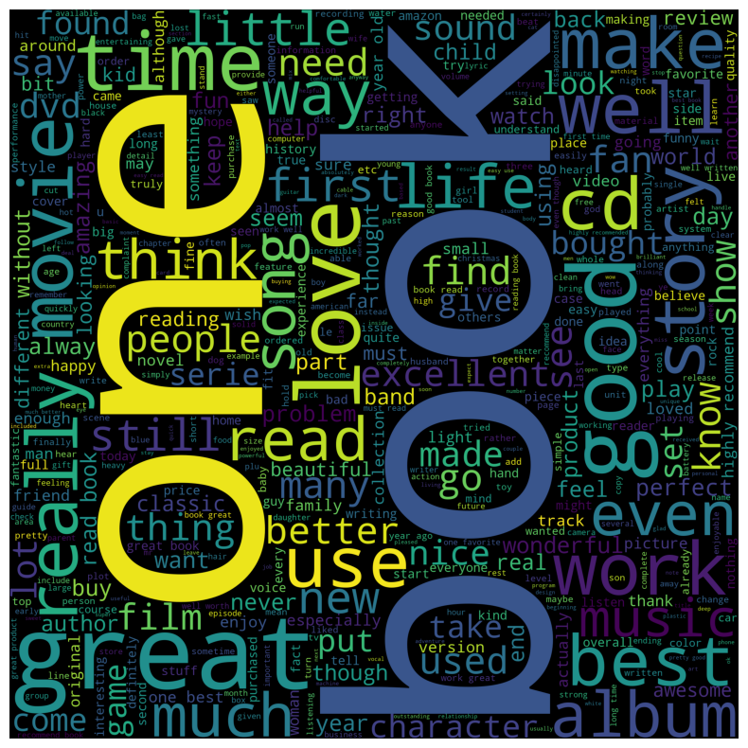
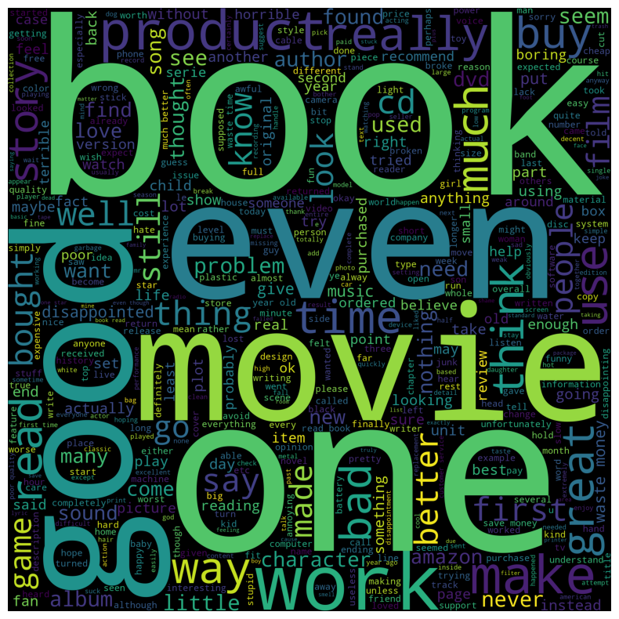
POSITIVE
Feature selection
Feature selection techniques are used to choose the most relevant features for model training while discarding irrelevant or redundant ones.
This helps in reducing dimensionality and improving model performance.
We utilize a word cloud to analyze the predominant features present in both positive and negative comments.
NEGATIVE
9

Slide 10


Count Vectorizer
Converts text into a matrix with rows representing documents and columns representing unique words.
Counts the occurrences of each word in the document, resulting in a sparse matrix.
Does not consider the importance of words; focuses solely on their occurrence.
Vectorization
Vectorization is the process of converting text data into numerical vectors, which can be understood by machine learning algorithms.
Techniques like bag-of-words (BoW), term frequency-inverse document frequency (TF-IDF), and word embeddings (e.g., Word2Vec, GloVe) are commonly used for vectorizing text..
TF-IDF (Term Frequency-Inverse Document Frequency)
Calculates word importance by considering both frequency in a document and rarity across the corpus.
Assigns a weight to each word based on its term frequency (TF) and inverse document frequency (IDF).- TF-IDF score indicates a word's significance relative to the entire corpus.
Words with higher TF-IDF scores are more crucial for distinguishing between documents.
10

Slide 11
Unigrams
Unigrams are single words extracted from the text. Each word in the text constitutes a unigram. For example, in the sentence "The quick brown fox jumps over the lazy dog," the unigrams are "The," "quick," "brown," "fox," "jumps," "over," "the," "lazy," and "dog."
N-grams
N = 1
N-grams are contiguous sequences of n items, which can be words or characters, extracted from text data.
They capture local context and sequential information present in the text.
N-grams are generated by sliding a window of size n over the text, extracting each consecutive sequence encountered.
For example, in a bi-gram (2-gram) approach, pairs of consecutive words or characters are extracted.
Incorporating N-grams as features in natural language processing tasks allows algorithms to consider the context and ordering of words or characters, improving performance in tasks such as text classification and sentiment analysis.
Bigrams
Bigrams consist of pairs of adjacent words in the text. They provide information about the co-occurrence of two consecutive words. For example, in the same sentence, the bigrams would include "The quick," "quick brown," "brown fox," "fox jumps," "jumps over," "over the," "the lazy," and "lazy dog."
N = 2
Trigrams
Trigrams are sequences of three consecutive words extracted from the text. They offer more context compared to unigrams and bigrams. For instance, in the given sentence, trigrams would include "The quick brown," "quick brown fox," "brown fox jumps," "fox jumps over," "jumps over the," "over the lazy," and "the lazy dog."
N = 3
Ngrams
N-grams with larger values of n: Similarly, n-grams can be extended to include sequences of more than three words, such as 4-grams (four consecutive words), 5-grams (five consecutive words), and so on.
N > 4
11

Slide 12

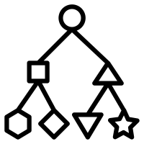
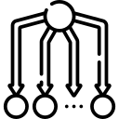

Supervised Learning - Classification
Tree based models:
Decision Tree: Captures complex data relationships, resilient to imbalance.
Random Forest: Ensemble strength for improved accuracy in imbalanced settings.
Multinomial Naïve Bayes:
Probabilistic Classification: Multinomial Naive Bayes calculates class probabilities based on word frequencies in documents.
Effective in Text Classification
Sensitivity to Feature Frequency
Balanced Metric Emphasis:
Precision: Ensures accurate positive predictions, minimizes false positives.
Recall: Captures true positives, minimizes false negatives.
F1 Score: Harmonizes precision and recall for comprehensive evaluation.
12

Slide 13
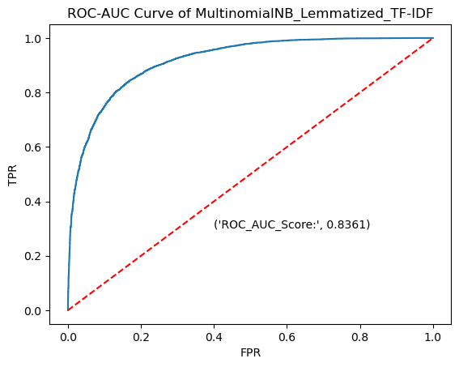
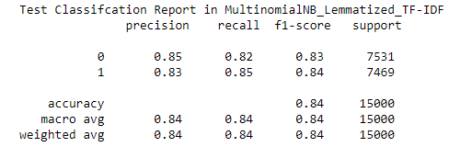
Recommender system
Best fit model --- Multinomial NB_Lemmatized_TF-IDF
6183
1348
0
1112
6357
1
0
1
13

Slide 14




Market factors (1/2)
This aspect of the sentiment analysis recommendation system involves leveraging sentiment analysis results to suggest products or services that resonate with users' sentiments. Here's a detailed explanation
Description
Sentiment Analysis Results
After analyzing user feedback or reviews, the sentiment analysis component categorizes sentiments into positive, negative, or neutral.
This analysis determines the overall sentiment conveyed in the user's input
Positive Sentiments
For users expressing positive sentiments, the recommendation system suggests products or services that have received positive reviews, high ratings, or favorable feedback from other users.
These recommendations aim to reinforce positive experiences and preferences, enhancing user satisfaction and engagement.
Negative Sentiments
Conversely, for users conveying negative sentiments, the system recommends products or services that have addressed common criticisms or received positive feedback after improvements.
By suggesting solutions or alternatives to address users' concerns, the system aims to mitigate dissatisfaction and improve user experience.
14

Slide 15


Market factors (2/2)
Description
Personalization and Context
The recommendation system may consider additional factors such as user preferences, past interactions, demographic information, and contextual relevance when making recommendations.
Personalization ensures that recommendations are tailored to individual users, taking into account their unique tastes, preferences, and behavioral patterns.
Contextual relevance factors in the specific context or scenario in which the user's sentiment was expressed, ensuring that recommendations are appropriate and meaningful
Continuous Improvement
The recommendation system continuously learns and adapts based on user feedback and interaction data.
By monitoring user responses to recommended products or services, the system refines its recommendations over time, striving to provide increasingly relevant and valuable suggestions.
Continuous improvement ensures that the recommendation system remains effective and responsive to changing user sentiments and preferences, ultimately enhancing user satisfaction and engagement.
15

Slide 16

References
D. Law, R. Gruss, A. S. Abrahams, Automated defect discovery for dishwasher appliances from online consumer reviews, Expert Systems with Applications, 67(2017): 84–94
N. Sultana, P. Kumar, M. Patra, S. Chandra and S. Alam, "Sentiment analysis for product review", ICTACT J Soft Comput, vol. 9, no. 03, 2019
J. Liu, S. Zheng, G. Xu et al., "Cross-domain sentiment aware word embeddings for review sentiment analysis", Int. J. Mach. Learn. & Cyber., vol. 12, pp. 343-354, 2021
W. Tan, X. Wang and X. Xu, "Sentiment analysis for Amazon reviews", International Conference, pp. 1-5, 2018
15

Slide 17
Thank You
Namia

